Slide 1
Fall Term 2022 Student Engagement Survey Highlights
Early year engagement survey (eyes)
Administered November 2022
Notes:
Presentation created February 2023 by Ashley Sears (ashley.sears@clackamas.edu)

Slide 2
Today’s Roadmap
Introduction to EYES
Distribution
Respondents
Results
How to Access Results

Slide 3
What is the EYES Survey?
Administered end of both Fall & Spring Terms
Goals:
Educational and Career Planning
Assess student engagement
Understand students’ perceptions of effectiveness
Identify challenges affecting students
Check in on online learning experiences and needs
Collect data for grants (e.g., Title III)
Notes:
Administered during November (Fall) and May (Spring)
The EYES is *not* a pre/post assessment
Mention Fall is *EARLY* Year and Spring is *END* of Year
In all things, *employees*, *not students*, are determining what “engagement” means. Ideas are rumbling around to shift this.
The Transportation survey is a separate, optional survey at the end

Slide 4
Distribution
To receive the survey, students must:
Maintain enrollment in Fall Term 2022
Not have a primary program of Community Ed or High School
Not be solely high school or Customized Training students
Be credit-seeking
Be enrolled in CCC courses
Sent to nearly 4,500 students via email
Advertised:
Posters
Reader Boards
Facebook
Student Portal
Student Bulletin
FYI Today
Notes:
Total number of students: 4,486
Total responses: 696

Slide 5
Respondents
16%
Overall
Response Rate
Race & Ethnicity
Legal Sex
15%
22%
Students of Color
Female Students
16%
10%
White Students
Male Students
11%
4%
Unknown
Non-Binary & Unknown
Notes:
Total number of students: 4,486
Total responses: 696
No differences in Race/Ethnicity response rate
Females outweigh Males 2:1 in the survey results (this is typical)

Slide 6
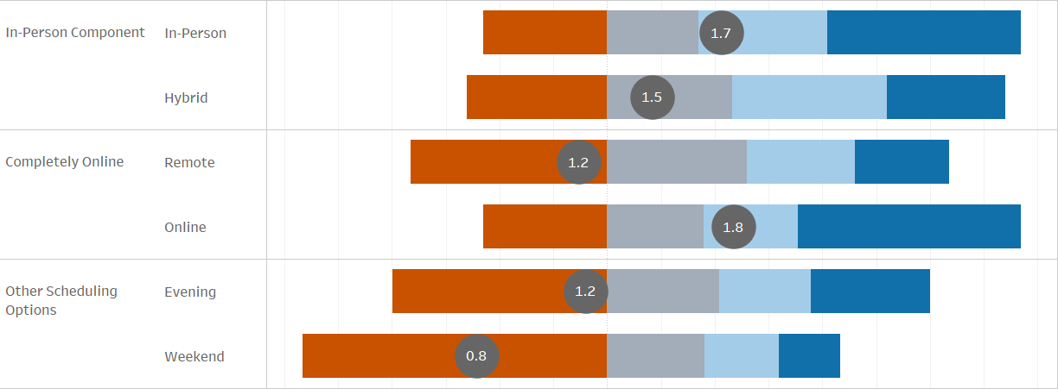
Results: Modality Preferences
Notes:
In-Person courses had a slightly higher positive endorsement than Spring 2022 (1.4 to 1.7)
Slight decrease in preferences for Remote and Online – these may not be a trend
Parents/guardians are more likely to “prefer a lot” Online
Non-parents more likely to “prefer a lot” In-person
First Gen – more likely to “prefer a lot” both Online and Evening courses
Those who work 30+ hrs more likely to “prefer a lot” both Online and Evening courses
Students were also asked about Course Days and Times (start times)
No change since Spring 2022
Responses concentrated between 10am and 3pm (especially 10am-noon), Monday - Thursday

Slide 7
Results: Educational & Career Planning
 | Fall 2021 | Fall 2022
Someone at CCC helped me explore program options | 65% | 59% | v
Someone at CCC helped me explore career options | 46% | 42% | v
Someone at CCC helped me choose a program of study | 43% | 43%
An advisor helped me set academic goals and create a plan for achieving them | 48% | 57% | ^
CCC provided clear information so I could select courses I need to reach my goals | 72% | 72%
Notes:
Percentages are “Agree” and “Strongly Agree” combined
Note that 62% of students indicated they knew what they wanted to study when they started at CCC and are still in this program.
“Explore Career Options” had the lowest ratings. These were particularly low for Business EFA students (followed by Social Sciences, STEM, and then Creative Arts)
Negative scores were more likely to come from:
Female students
White students
Veterans (first 4 questions)

Slide 8
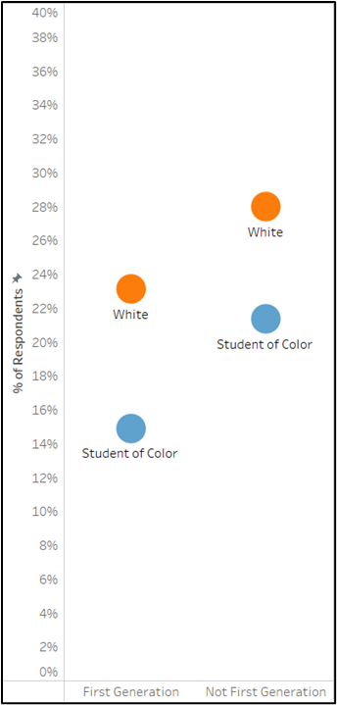
Results: Co-enrollment
76% of students (n=528) had not heard of co-enrollment.
Only 25% (n=26) of students who indicated they intend to graduate from CCC then transfer had heard of co-enrollment.
STEM EFA students were most likely to have heard of co-enrollment (33% | n=31). They were also the most likely to indicate they plan to earn a degree at CCC and transfer to a 4-year institution (65% | n=61).
Race/Ethnicity and First-Generation status interacted, with First Generation Students of Color least likely to have heard about co-enrollment
Notes:
Co-enrollment means participation in our Degree Partnership program with 4-years like PSU.

Slide 9
Results: Barriers Experienced
Top 5 Barriers in 2022 | Fall 2021 | Fall 2022
Work outside of college | 37% | 42% | ^
Household finances (rent, bills, groceries) | 20% | 30% | ^
Difficulty paying tuition and fees | 21% | 28% | ^
Mental health issues | 27% | 27%
Difficulty paying for books and supplies | 19% | 25% | ^
 | n = 1,113 | n = 696
Notes:
Percentages are “Moderately a reason” and “Very much a reason”
There are others that indicated these are barriers, but said these were only “Slightly” or “Somewhat” a reason
This is organized for the Top 5 Barriers in Fall 2022 (listed most to least)
54% of students noted that all three financial barriers affected their progress at least a little (slightly a reason +)
Entire list of barriers:
Work outside of college 42%
Household finances (rent, bills, groceries) 30%
Difficulty paying for tuition and fees 28%
Mental health issues 27%
Difficulty paying for books and supplies 25%
Family responsibilities / childcare 22%
Not knowing what I want to do with my education yet 21%
Transportation challenges or costs 20%
Difficulty getting the courses I need due to class scheduling conflicts 20%
Not feeling academically prepared (e.g., math, writing skills) 18%
Not knowing what courses I need to take or when 15%
Dislike participating in online courses 15%
Physical health issues 12%
Difficulty getting the courses I need due to courses being canceled 7%
Computer / internet access 6%

Slide 10
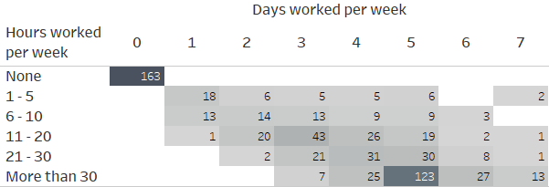
Results: Work Outside of College
Notes:
The common narrative that “All our student are working. And most are working full-time” is not accurate.
The vast majority are NOT working FT (lass than 1/3 work 30+ hrs/wk), and about 25% are not working at all.
Who works more?
Business and Teaching & Education EFA students
Those age 22-64 (so not the youngest or oldest students)
Hispanic students (more than White – Asian are least likely to be working 30+)
Non-PELL students.
First Generation students
Those in their first term at CCC
Those who work 30+ hrs/week more likely to endorse “work outside of college” as a significant barrier

Slide 11
Results: Online Learning & Digital Access
Pt 1
 | Fall 2021 | Fall 2022
Overall, CCC has helped me succeed in the online course format | 69% | 67% | v
CCC has helped me learn how to access all the systems I need for online learning. | 72% | 76% | ^
Note. Percentages are “Somewhat Agree” and “Completely Agree”

Slide 12
Results: Online Learning & Digital Access
Pt 2
Technology & Training Needs | Fall 2021 | Fall 2022
Provide information regarding available technology resources available to students. | 44% | 36% | v
Offer additional training for software like Zoom or Microsoft Office (Word, PowerPoint, Excel). | 30% | 23% | v
Connect me with additional technology, such as laptop loans, or increase access to computers, printers, webcams, the internet, or assistive technology. | 24% | 21% | v
Provide more technology troubleshooting for computer issues. | 23% | 15% | v
Other (please explain): | 15% | 11% | v
Notes:
Not every student responded to these questions (n=556)
66% of the students who requested support endorsed only one area
Percentages are out of only the students who requested some type of support
Other:
Thanks for offering chromebook check-out
Noting the difficulty in finding what they need in Moodle
Want more printed (or printable) course materials

Slide 13
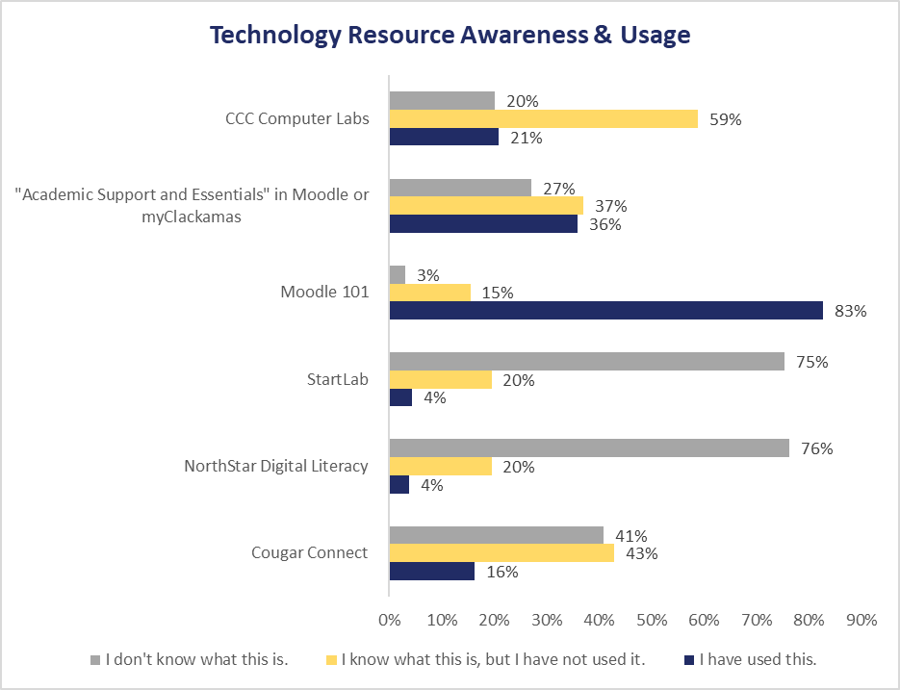
Results: Technology Resources
Notes:
While students may be requesting more support, they are generally unaware of available resources (except Moodle 101)
Students had the option to request an email about tech resources. They were more likely to be:
Hispanic
Age 30 and older.
Part of the Teaching & Education EFA or the Creative Arts, Communication & Humanities EFA

Slide 14
Results: Online Learning & Digital Access
Pt 3
Instructor Support Requested | Fall 2021 | Fall 2022
Create consistent online course layouts | 56% | 43% | v
Increase course-related communication and check-ins | 41% | 27% | v
Offer additional instruction on accessing online course materials (e-books, articles, etc.) | 36% | 23% | v
Add more opportunities to collaborate with students in my course(s) | 30% | 18% | v
Other (please explain): | 11% | 9% | v
Notes:
Only shown to students taking online courses
Other:
Many positive comments about instructors
Frequent requests for instructors to respond to email and grade assignments quicker
Comments asking for syllabi and due dates to be updated from previous terms

Slide 15
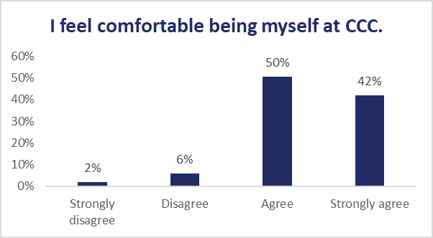
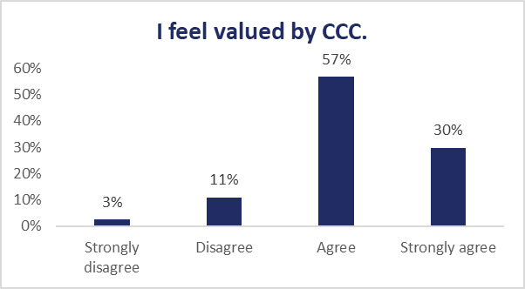
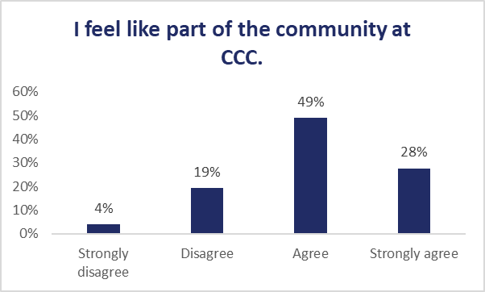
Results: Belonging
Notes:
National Survey of Student Engagement (NSSE)
Negative ratings were more likely (but not always) associated with:
Students of Color
First Generation students
Males
Working more hours / days per week
More likely to endorse more barriers
Want more collaboration opportunities & course check-ins in online courses
Rated the advising questions more negatively
More likely to have dropped or withdrawn from at least one course
More likely to be in their 20s
Positive ratings (strongly agree) were more likely (but not always) associated with:
Positive ratings on all the belonging questions
NOT more or less likely to be Students of Color
Positive ratings on advising questions
More likely to have heard about technology resources
More likely to be entirely online (community)
Less likely to endorse barriers
More likely to be parents/guardians
MORE DETAILS IN REPORT APPENDIX

Slide 16
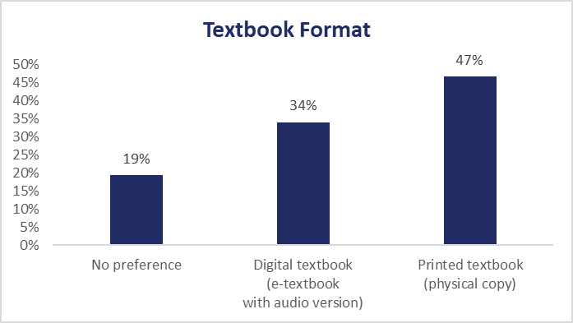
Special Section: Textbooks
50% of students got their textbooks from the CCC Bookstore/Website.
9% did not get all their textbooks. Most said this was because their instructor said they weren’t needed.
When asked about Inclusive Access, 31% said they weren’t sure if this would be beneficial while over 60% said it would be beneficial.
Notes:
Questions added for the Bookstore Taskforce

Slide 17
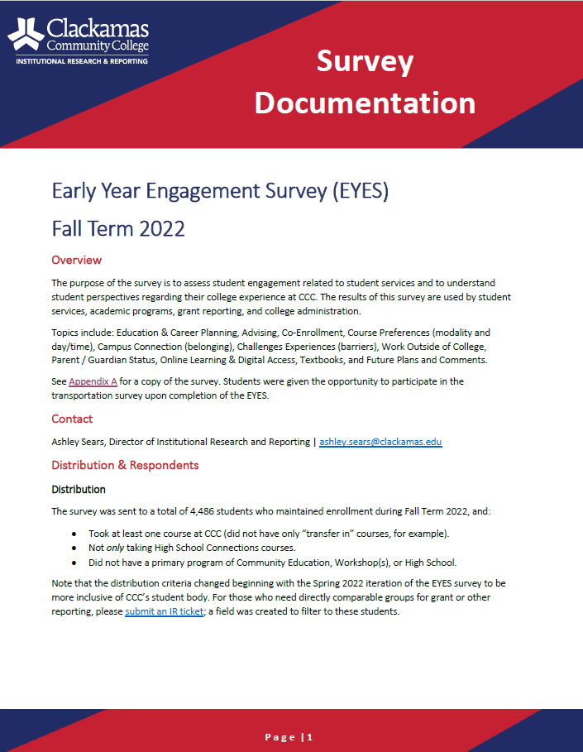
How to Access Results
How To: Access IR Moodle
EYES Survey Documentation
Notes:
IR Moodle: https://online.clackamas.edu/course/view.php?id=66529
IR Moodle KB Article: https://clackamas.teamdynamix.com/TDClient/1853/Portal/KB/ArticleDet?ID=138272
EYES KB Article: https://clackamas.teamdynamix.com/TDClient/1853/Portal/KB/ArticleDet?ID=148836

Slide 18
Wow, that was rad.
Access the ir moodle, kb articleS, or Contact IR for support
Notes:
IR Moodle: https://online.clackamas.edu/course/view.php?id=66529
IR Moodle KB Article: https://clackamas.teamdynamix.com/TDClient/1853/Portal/KB/ArticleDet?ID=138272
EYES KB Article: https://clackamas.teamdynamix.com/TDClient/1853/Portal/KB/ArticleDet?ID=148836

